Slide 1


Stationarity
Wake Forest
School of Business
_______

Slide 2
Basic Steps in a Forecasting Task
Problem definition
Gathering data
Preliminary (exploratory) analysis
Choosing and fitting models
Using and evaluating a forecasting model

Slide 3
Stationary Time Series
The properties of the series do not depend on the time at which the series is observed. That is, the mean, autocorrelations, etc are constant over time. Therefore:
Time series with trend are non-stationary
Time series with seasonality are non-stationary
Time series with cycles can be stationary (because the cycles are not of fixed length)
Stationarity allows you to assume that the statistical properties of the series will be the same in the future as in the past
Notes:
Note that an MA series is always stationary – An AR series may or may not be stationary. An ARMA series is stationary if the AR part is stationary.

Slide 4
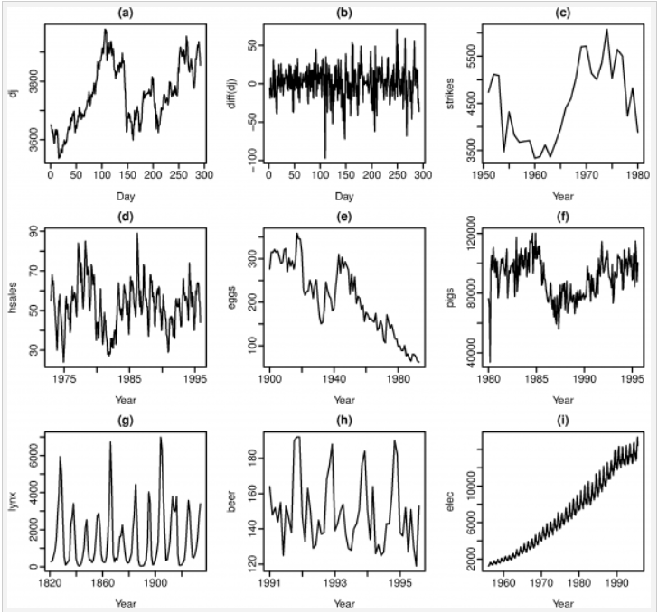

Slide 5
ACF and Stationarity
ACF quickly decays to 0 for stationary series.
ACF exhibits slow decay for non-stationary series. ACF(1) is often large and positive.

Slide 6
Addressing Stationarity
Trend stationary: stationary after accounting for (or removing) the trend
Difference stationary: the first differences of the series are stationary
NOTE: Differencing helps to stabilize the mean of a time series by removing changes in the level of a time series, and so minimizing the effect of trend and seasonality. Transformations such as logarithms can help to stabilize the variance of a time series.

Slide 7
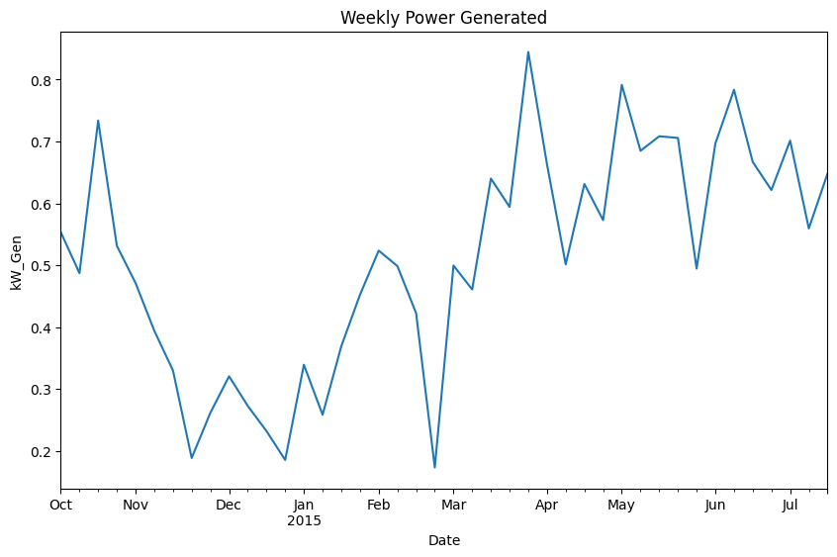
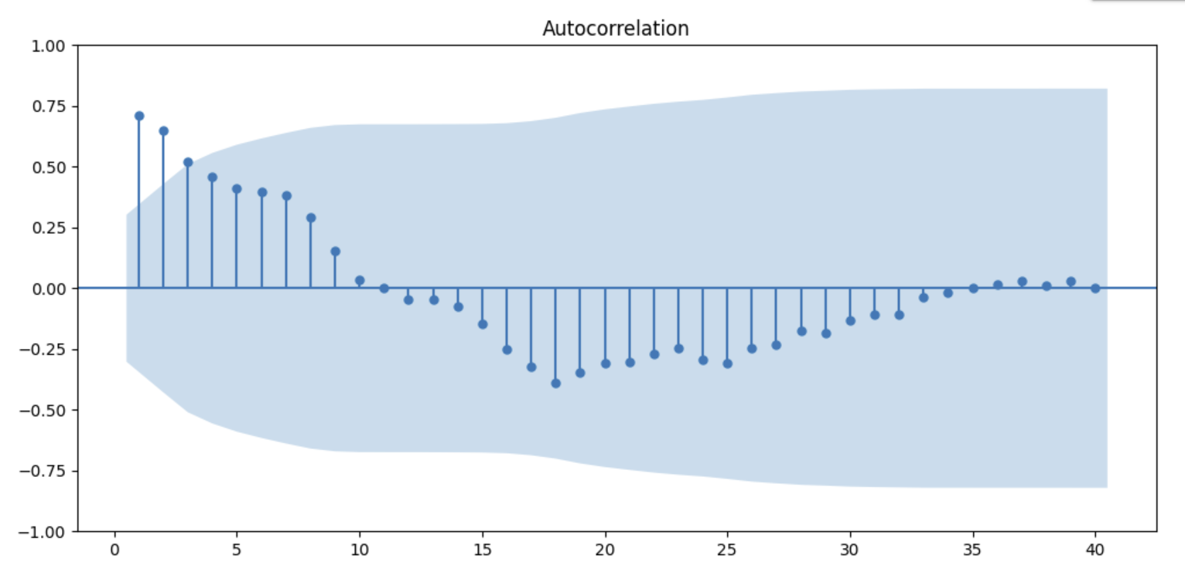
Stationary Series (Energy)

Slide 8
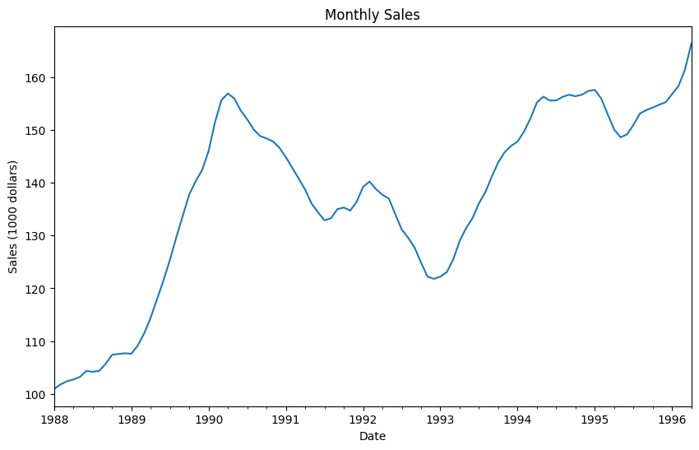
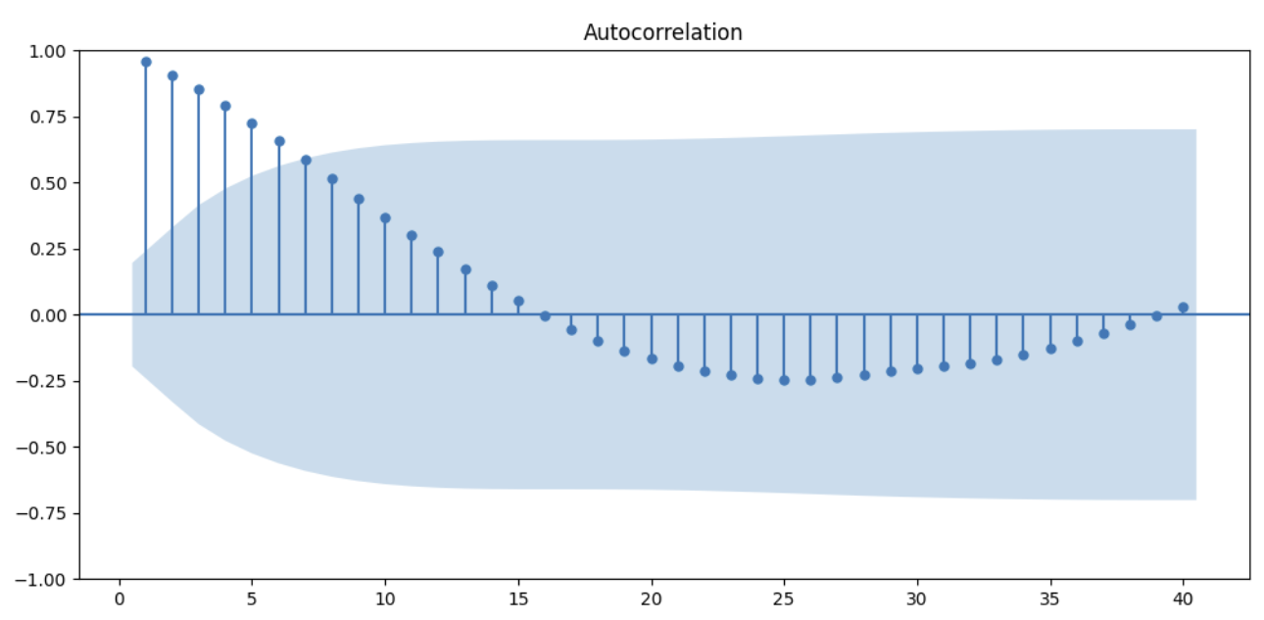
Nonstationary Series (Sales)

Slide 9
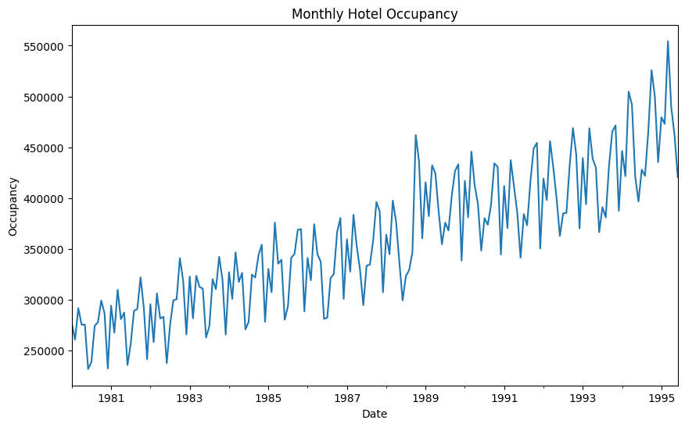
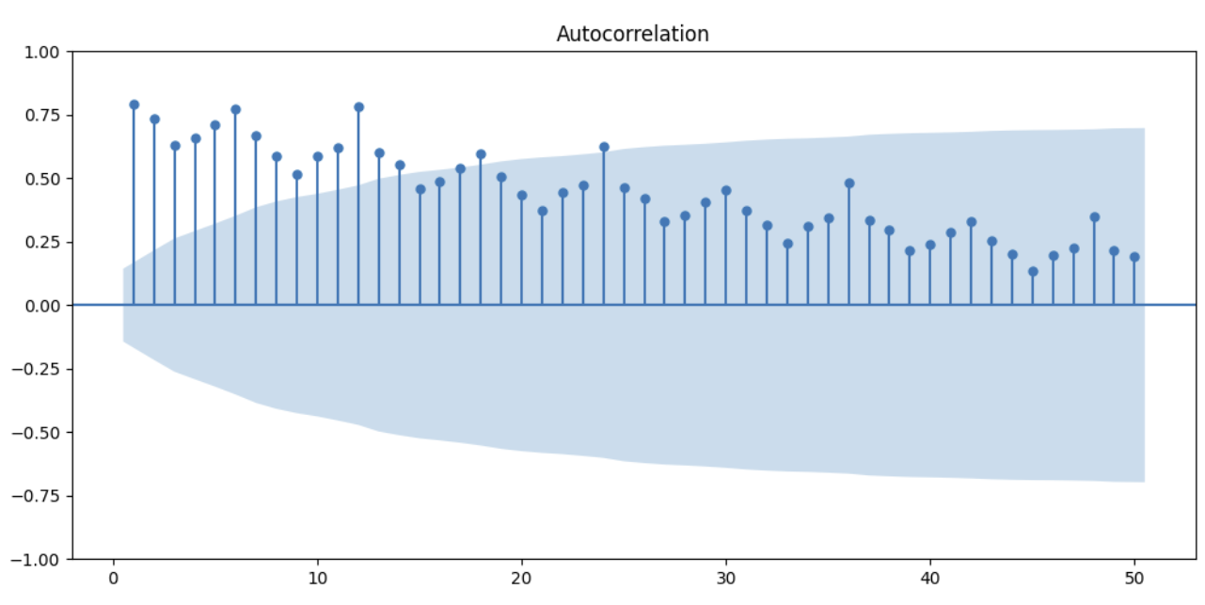
Trend Non-Stationary Series (Hotel Occupancy)

